Slide 1
Evaluate trends of misinformation on twitter in run-up to 2020 US presidential elections
Abhishek Bais, JIMMY LIANG, ROHAN KUMAR, Samer Baslan
(graduate students, Computer Science, san jose state university)
Dr. Vishnu pendyala (supervisor)
Notes:
Hi, My name is Abhishek Bais and together with Jimmy Liang, Rohan Kumar and Samer Baslan from the Dept of Comp Sci at SJSU, we evaluated trends in misinformation on twitter in the run-up to the 2020 US presidential elections

Slide 2
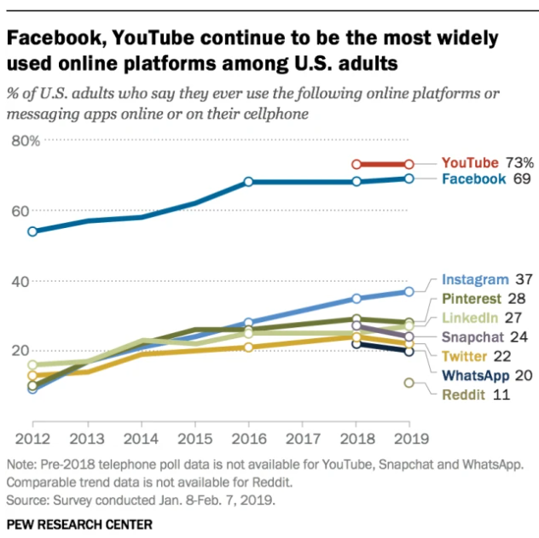
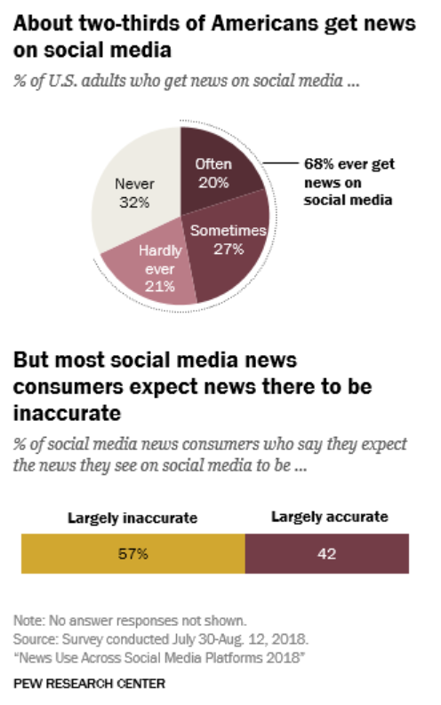
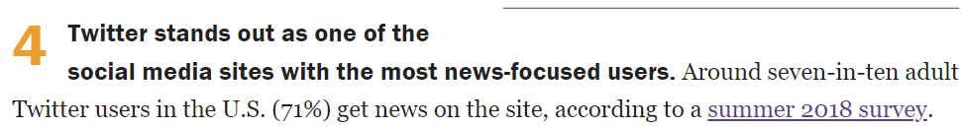
AMERICANS ON TWITTER
Notes:
According to a 2019 PEW Research survey, 71% of twitter users in the US or 1 in 5 Americans get their news from twitter despite them agreeing that 57% of the news feed on social media is largely inaccurate.

Slide 3

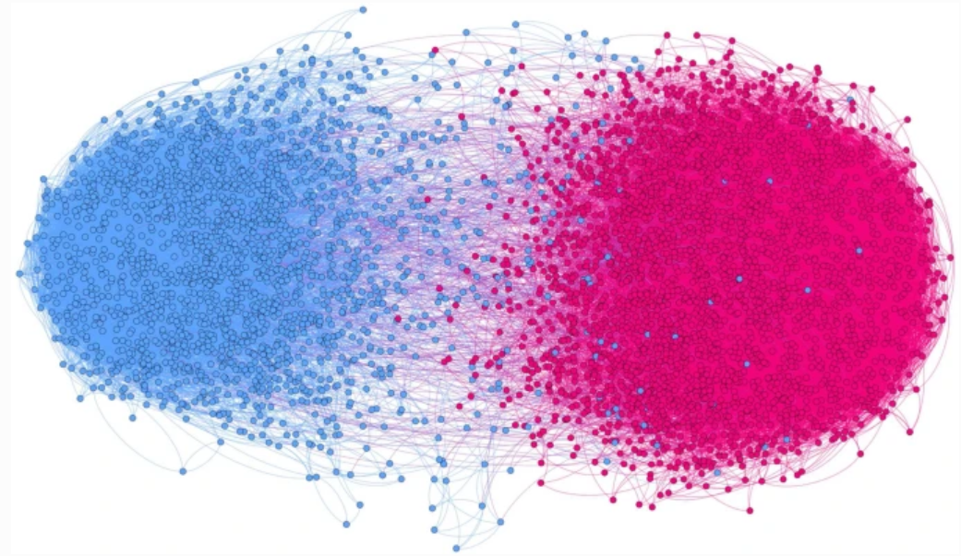
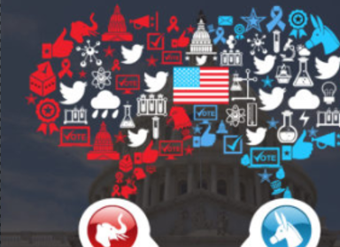
As People seek information that reinforce their beliefs, ECHO CHAMBERS are created
Notes:
where beliefs are amplified, rebuttals kept away. This human endeavor of confirmation bias provides breeding space for misinformation peddlers, looking to influence electoral minds to swing elections for benefit

Slide 4

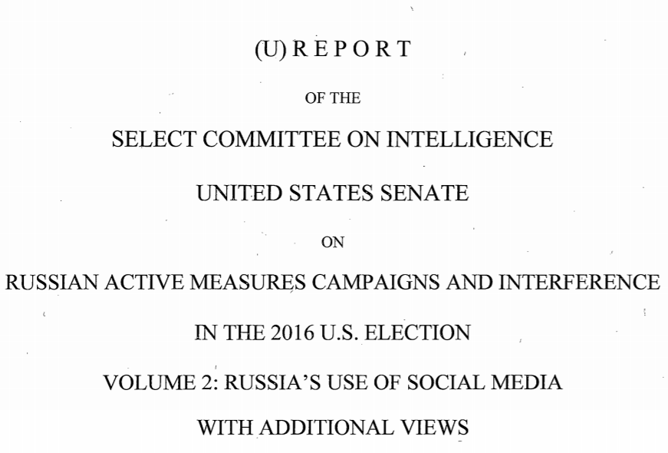
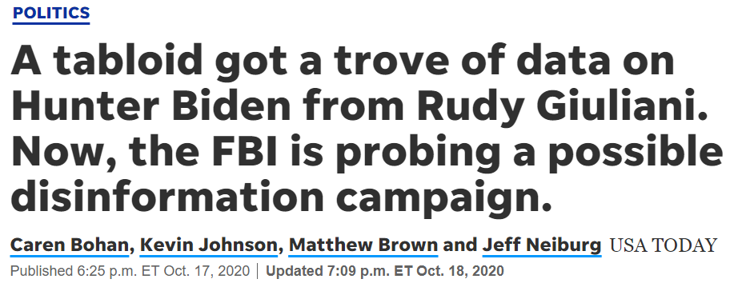
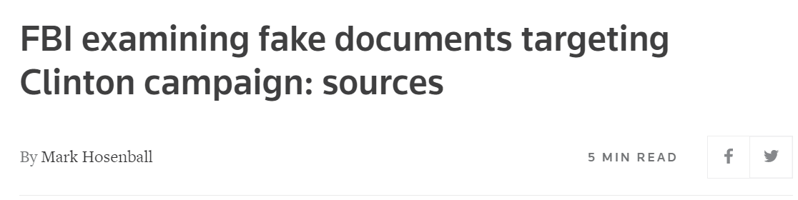
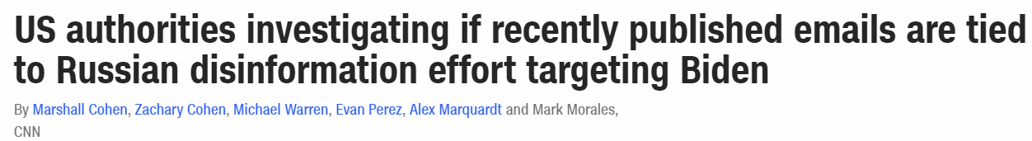
POST 2016 SEVERAL MISINFORMATION INVESTIGATIONS INVOLVING FBI AND US CONGRESS
Notes:
Have been conducted focused on foreign interference in US elections. While they concluded no voters were changed, they did find widespread misinformation in circulation.

Slide 5

AUTOMATIC MISINFORMATION DETECTION SYSTEM
Notes:
There is a need for an automatic misinformation detection system, now more than ever

Slide 6
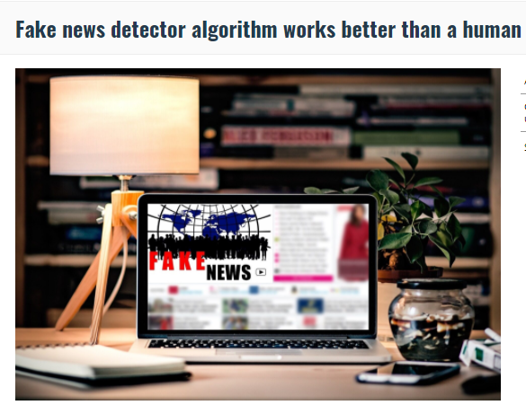
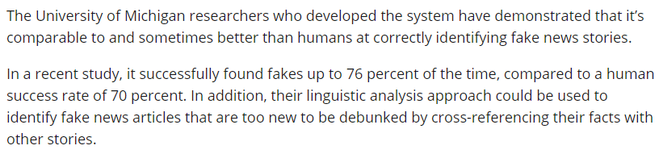
Veronica Perez-Rosas, Bennett Kleinberg, Alexandra Lefevre, Rada Mihalcea, “Automatic Detection of Fake News”, Proceedings of the International Conference on Computational Linguistics (COLING 2018), New Mexico, NM, August 2018
RELATED WORK - AUTOMATIC DETECTION OF FAKE NEWS (76% accuracy)
Notes:
In 2018, Umich researchers Perez-Rosas, Rada Mihalcea et all developed an automatic fake news detection system with 76% accuracy

Slide 7
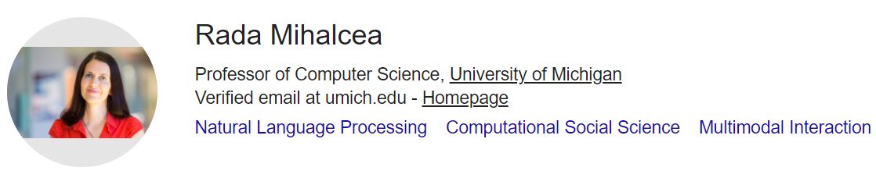
Mihalcea notes as key learnings in her paper
More than models, getting verified data is key challenge
Data from different domains have different characteristics
They used recent, 240 real news, 240 fake news items from reputed news sources, known fake news peddlers, 7 different domains, verified over days via paid crowdsourcing

Slide 8

Fact-Checked corpus
15,712 older, real news from reputed sources
12,999 older, fake news from known fake news peddlers
Only 1 domain – 2016 US presidential cycle
Collective wisdom corpus
1.7 million tweets
970,919 referencing Trump
776,886 referencing Biden
From 2020 presidential cycle
OUR WORK - AUTOMATIC MINSINFORMATION DETECTION SYSTEM
Notes:
We not only wish to evaluate trends in misinformation but also study Can an older, fact-checked news together with collective wisdom of tweeters obtained via sentiments & skepticism aggregation be an alternate to expensive crowd-sourcing based validation methods

Slide 9

DATA EXPLORATION OF FACT-CHECKED CORPUS OF 28,711 TWEETS FROM 2016 ELECTIONS

Slide 10
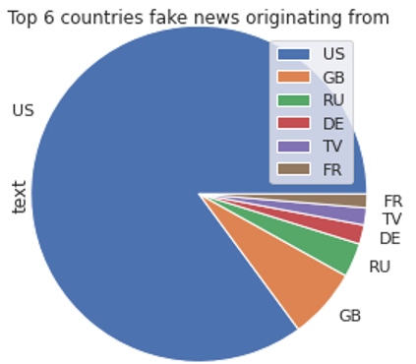
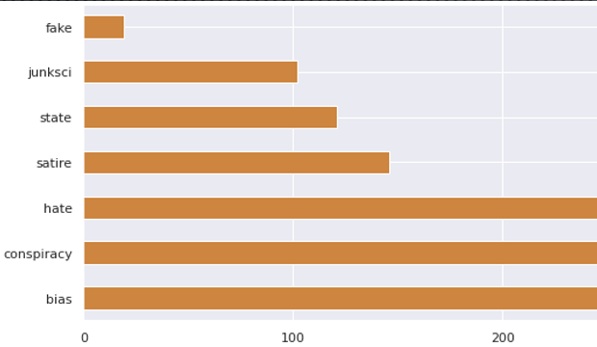
KINDS OF MISINFORMATION

Slide 11
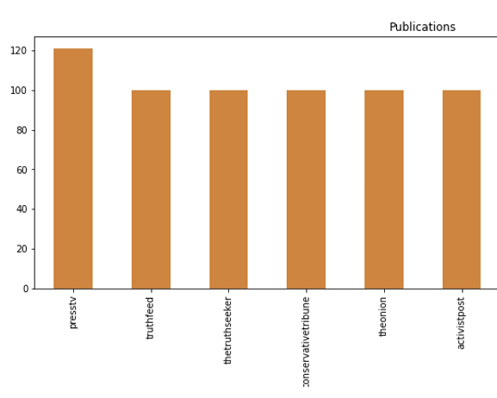
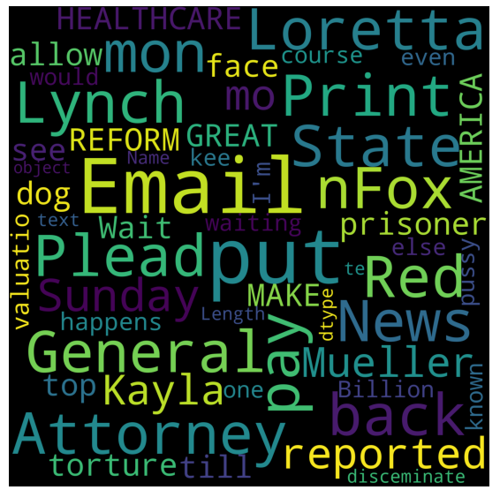
SOURCES OF MISINFORMATION

Slide 12



IRAN
RUSSIA
WHITE SUPREMECIST BACKED ORGS
top SOURCES OF MISINFORMATION

Slide 13
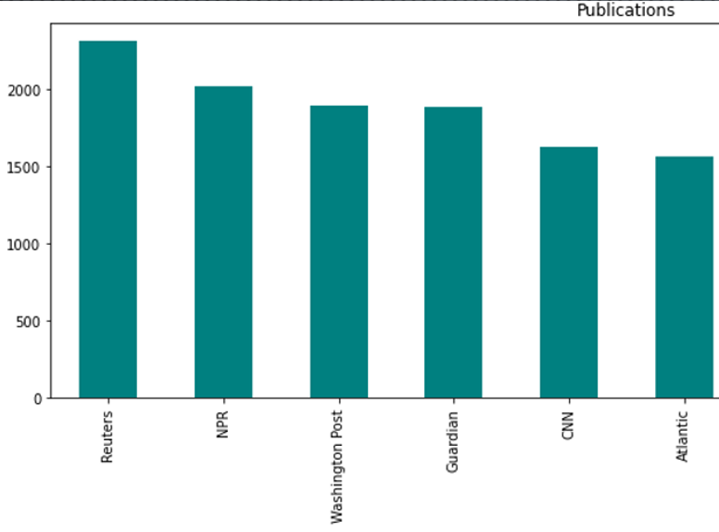
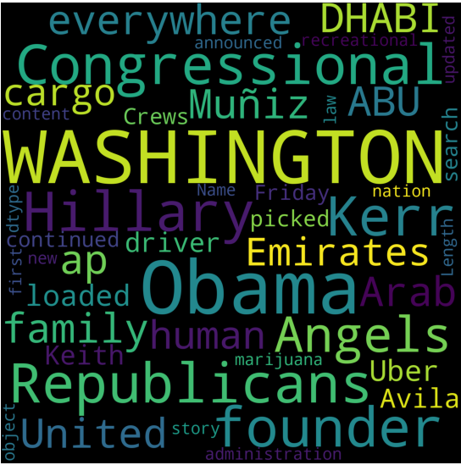
SOURCES OF REAL NEWS

Slide 14
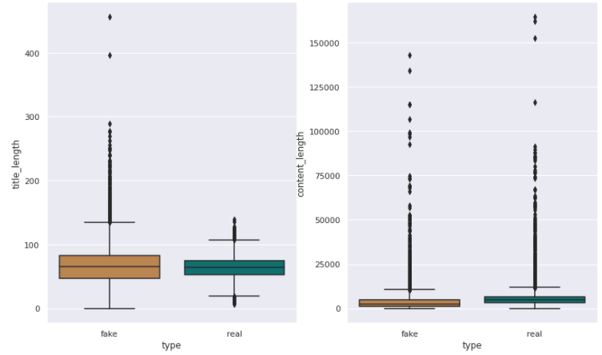
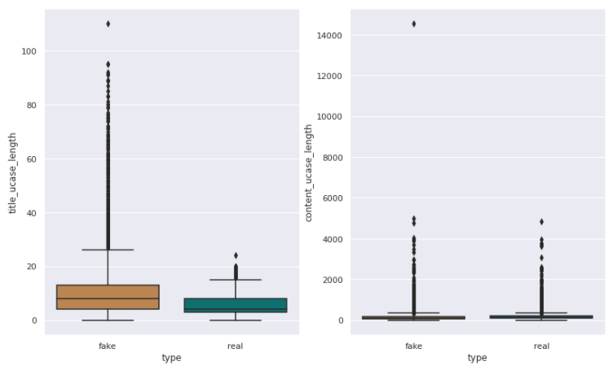
CHARACTERISTICS OF TWEETS RELAYING MISINFORMATION, REAL NEWS
Notes:
Fake news were found to have longer titles and capitalization

Slide 15
DATA EXPLORATION OF 1.7 MILLION TWEETS CORPUS FROM 2020 ELECTIONS

Slide 16
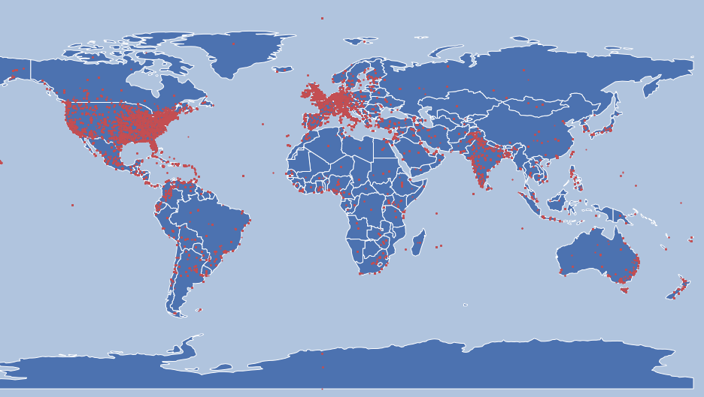
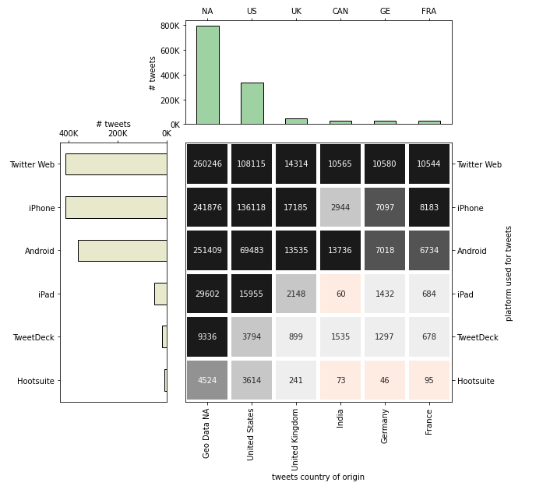
REGION OF TWEET ORIGIN

Slide 17
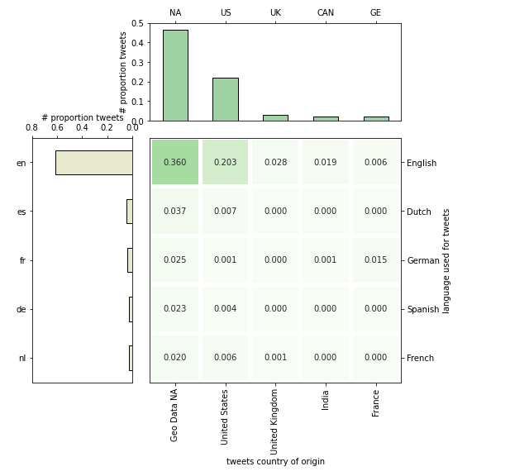
LANGUAGE OF TWEET
Over 60% OF THE TWEETS WERE IN ENGLISH, 20% FROM THE USA

Slide 18
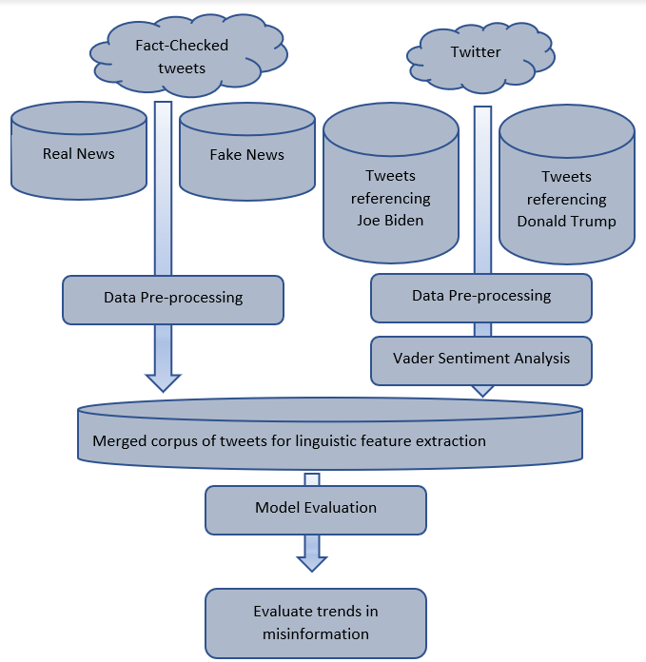
System architecture
HYBRID APPROACH
FACT-CHECKING
COLLECTIVE WISDOM OF TWEETERS
VOLUMNIOUS TWEET CORPUS FROM VARIETY OF SOURCES, VERIFIED IN PART BY HUMANS AND IN PART BY SENTIMENT AND SKEPTICISM AGGREGATION, ADDS VERACITY

Slide 19
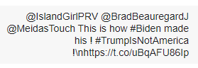
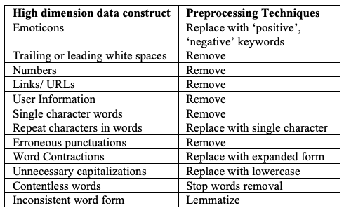
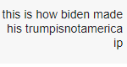
DATA PREPROCESSING
Notes:
The first step in classifying news as a real or fake is

Slide 20
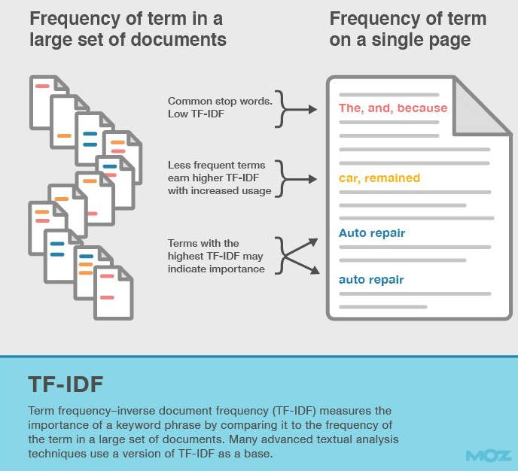
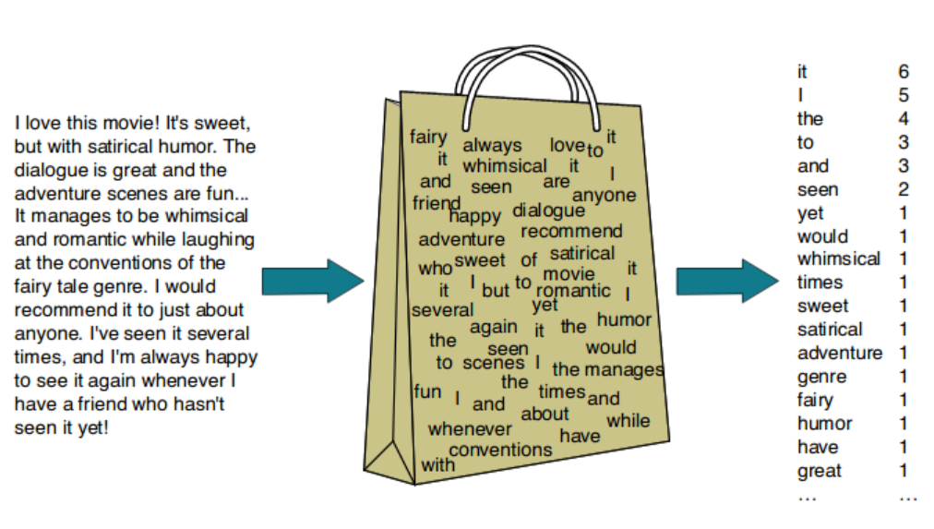
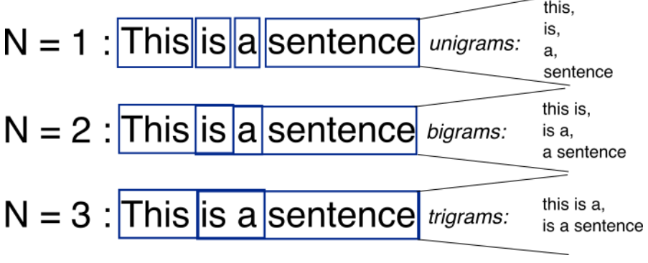
LINGUISTIC FEATURE EXTRACTION
Notes:
Next

Slide 21
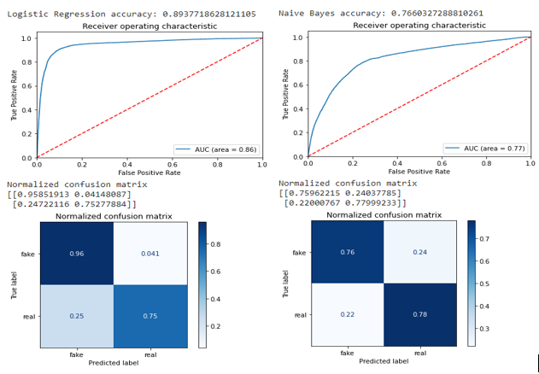
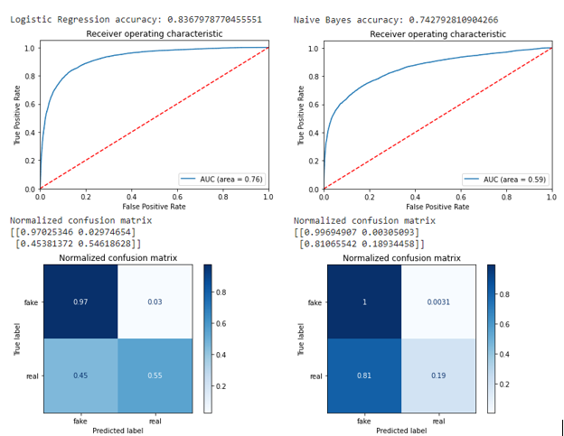
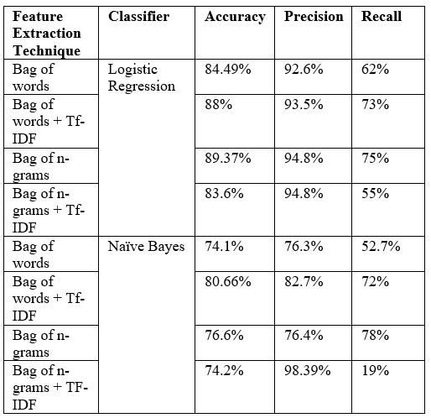
86%
76%
BoW + Tf-IDF
Bag of Ngrams + Tf-IDF
Model performance
LOGISTIC R, NAÏVE BAYES EVALUATION
Notes:
Finally the classification is evaluated using different machine learning models. In our work we obtained an average accuracy of 76.39% similar to Perez, et all’s work. This suggests collective wisdom of tweets can be a viable alternative to expensive crowdsourcing methods for news validation

Slide 22
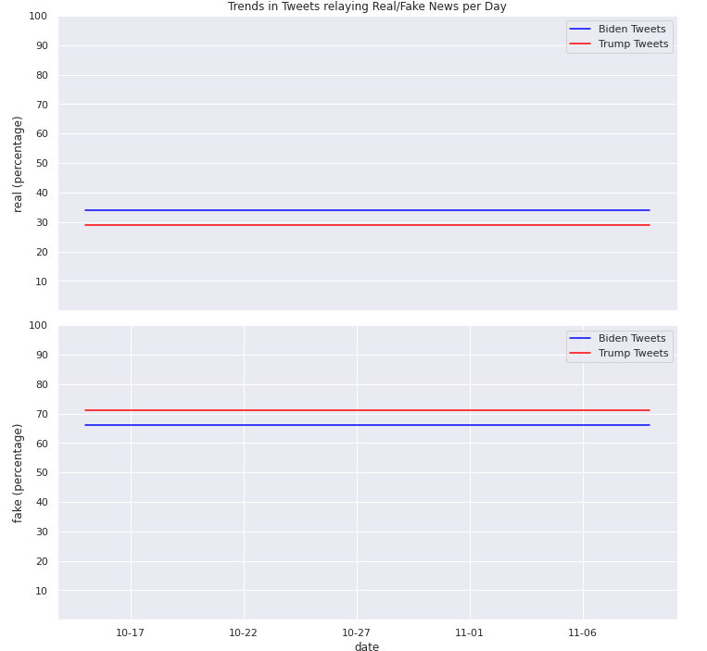
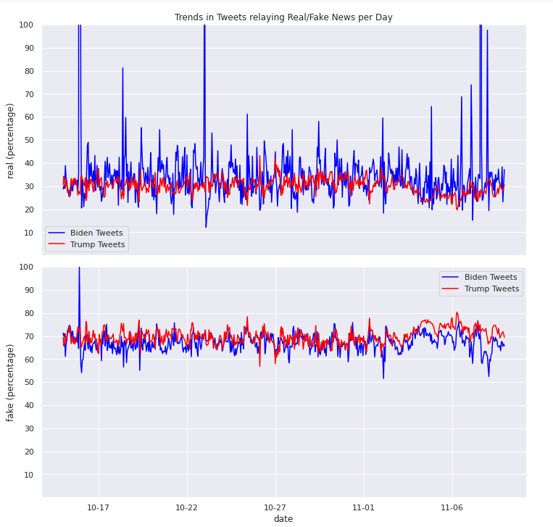
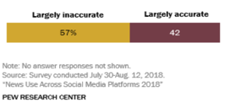
Misinformation 65-71%
Real news 30-35%
Joe Biden referencing tweets have 6% higher real news, 5% lower misinformation circulation
Elections vs Other times
8-14% higher misinformation circulation
7-12% lower real news circulation
TIME SERIES EVALUATION OF TRENDS IN MISINFORMATION, REAL NEWS
Notes:
Based on the confidence in the model, when time series results were evaluated it was found

Slide 23

Thank You

